Slide 1
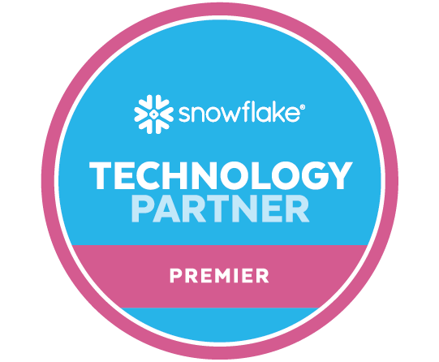

The Data Productivity Platform for the Modern Data Cloud
May 2023

Slide 2
Elevating DataOps

Slide 3
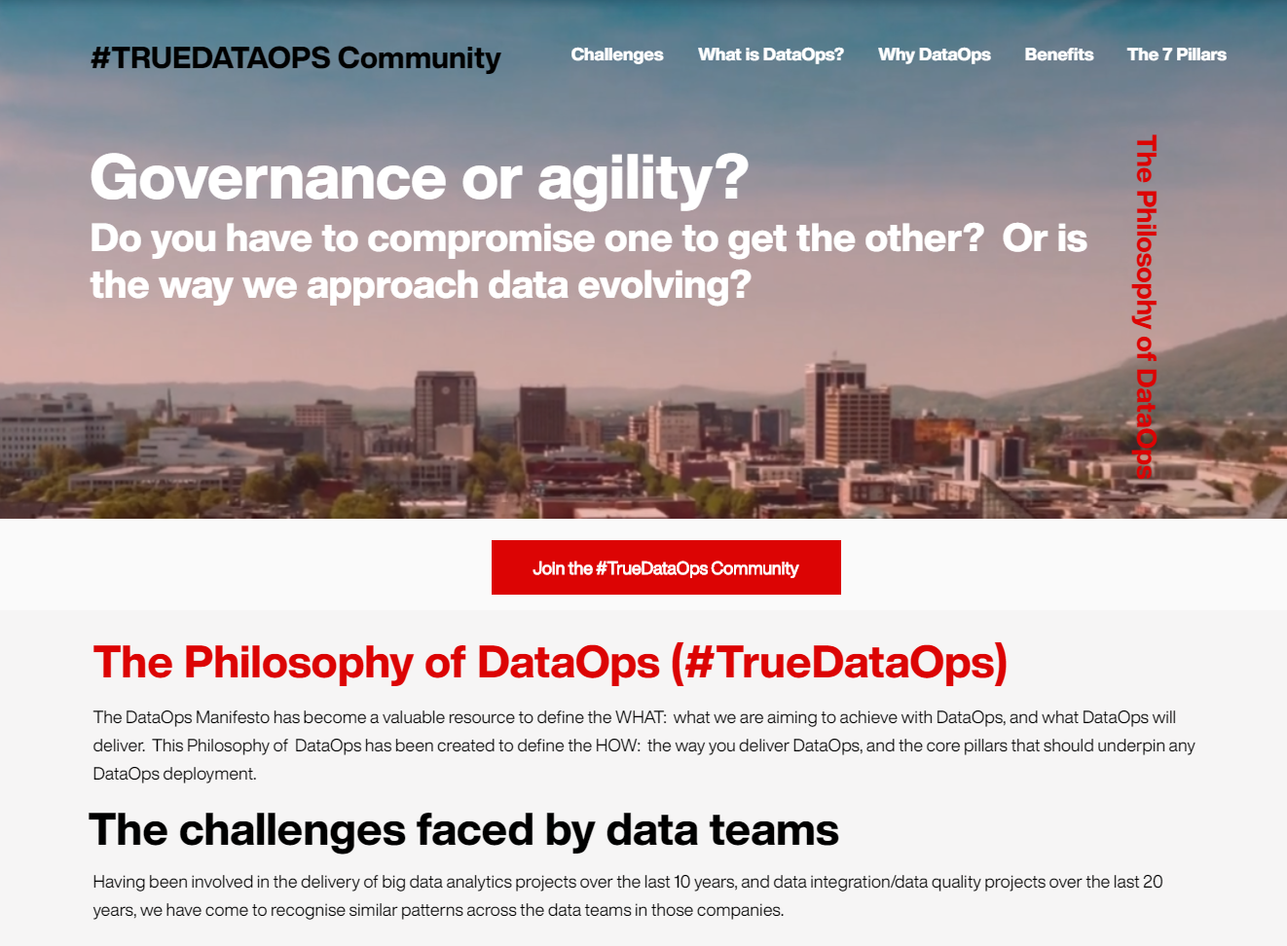
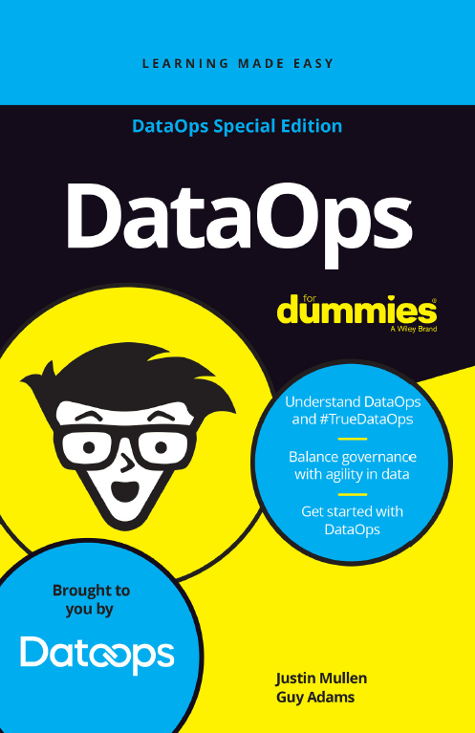









We started by creating a DataOps philosophy
Kent Graziano
Justin Mullen
Guy Adams
Wayne Eckerson
Truedataops.org
Mike Ferguson
DataOps for dummies
The contributors

Slide 4

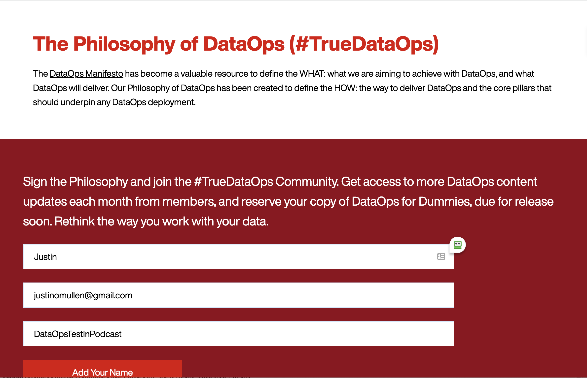
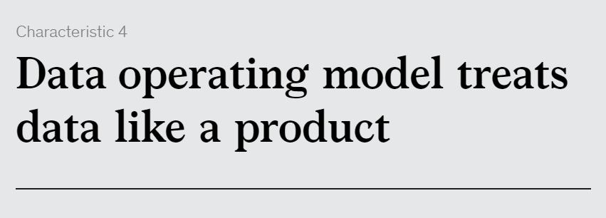
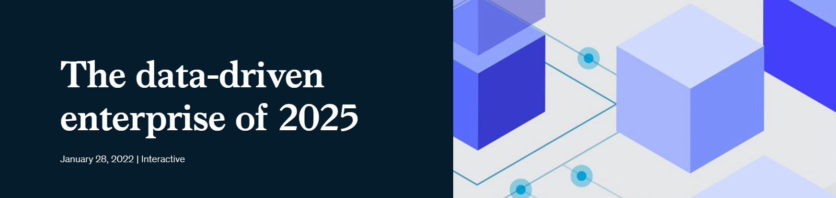

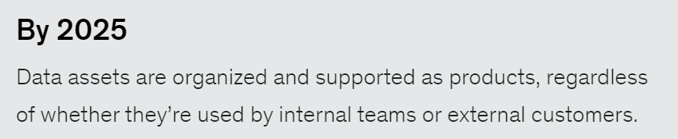
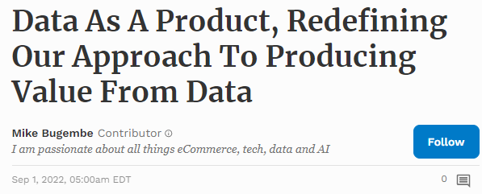

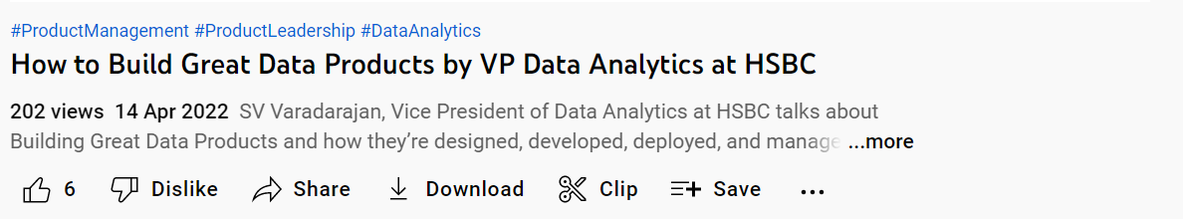

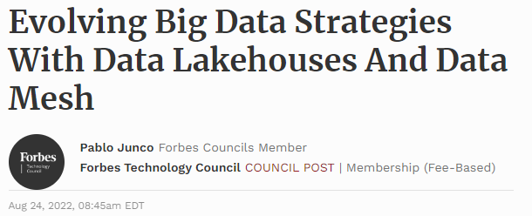
“Data Products” or “Data-as-a-Product”
DataOps.live have been talking about how we build, test and deploy “Data Products” since 2019.
“Data Products” (Guy & Justin)
www.truedataops.org (June 2019)
DataOps for Dummies (July 2021)
This terminology has gained mainstream adoption in 2021 and 2022.
Notes:
Terminology like Data Products and Data as a Product has gained widespread adoption in 2021 and 2022
Trusted advisors like McKinsey are talking about Data Products a one of 7 characteristics of the “data driven enterprise of 2025”
Global business media companies like Forbes are talking about “Data as a Product”
Mainstream businesses like HSBC are presenting about “how to build great data products”
DataOps were at the forefront of this from 2019 and 2020.
TrueDataOps
DataOps 4 Dummies
How do we build test and deploy data products …. The same way we have done in the software world for the last 20 years
click
Data Products are common speak in Enterprise organisations today. Product ownership moving to business leaders.

Slide 5


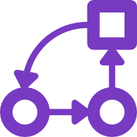






#TrueDataOps: 7 pillars
ELT and the spirit of ELT
lift and shift data—limit ETL wherever possible
building for the future that you can't yet anticipate
Collaboration and self-service
Agility and CI/CD
enable data access for the entire
company but maintain governance
repeatable and orchestrated pipelines
for building/deploying everything data
Automated testing
and monitoring
Component design
and maintainability
test-driven data development, automated test cases,
external monitoring
small atomic and testable pieces of code and configuration
Governance, security,
and change control
Environment management
branching data environments like we branch code
grant management, anonymization,
security, auditability and approvals

Slide 6

DataOps Practices and Tools = 10x Productivity
By 2025, a data engineering team
guided by DataOps practices and tools
will have been 10 times more productive
than teams that do not use DataOps.
1 release every 3 months
120 releases per month
Notes:
Roche case study reference: https://www.dataops.live/case-studies-roche
Data engineering is the discipline of translating data into usable forms in a timely manner that meets consumer demands. At the same time, it involves managing data debt early in the process by considering governance, data shareability, reusability, cataloging and compliance requirements.
DataOps is an agile and collaborative data management practice focused on improving the communication, integration, automation, observability and operations of data flows between data managers and data consumers.
By enriching your data engineering effort with DataOps practices, D&A leaders can achieve several good data SLAs like availability, freshness, concurrency of access, release velocity, code quality, service impact, service tickets, usage, reusability and self-service.

Slide 7
Problem We Solve

Slide 8







Data Platforms are complicated and very manual
…with tools from many vendors
Everything is manual and DIY = brittle
Stakeholders do not trust their data
  MIT Sloan Management Review study – 9% of execs trust data is accurate and 6% trust data is complete
Automated data testing is non-existent
Changes and new data sources take
too long
Managing (Dev/Test/Prod) environments
are complex and time-consuming
Governance is difficult to document/maintain
Visualization
Data ingestion
Data prep
Machine learning
Data science

Slide 9
Primary Challenges of Data Teams
Over-run with demand – can't deliver – big backlogs
All still manual
      building integration jobs
      testing and retesting jobs
      assembling data pipelines
      managing dev / test / production
Minor production changes take weeks or sometimes months to implement
50% of time is hijacked with work they didn’t plan
Plagued with comments like – “I can't trust the data”
Loading new data just “takes too long”

Slide 10
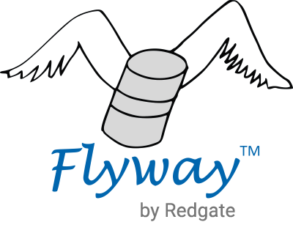
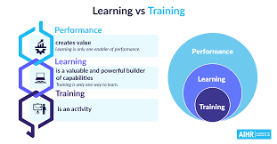
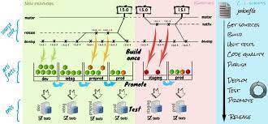
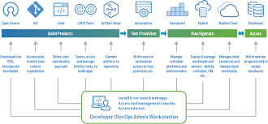








Manual
3 to 6 months: select OS tools, training, manual integration code and release management
Start development, manual integration, brittle infrastructure, no automation
Build/DIY
Use case 1
Use case 2
Use case 3
Use case 4
Use case 5
Automated
consumption
Time to value
Requirements to business value
in weeks!
Automated
Environment management, Orchestration, Documentation and Testing
Improved
Observability Governance
Security and Trust
Accelerate
Analytics, AI/ML and Powered By applications
on Snowflake
Notes:
Eliminates Time to get started on the right tools to get started

Slide 11
Value Proposition

Slide 12
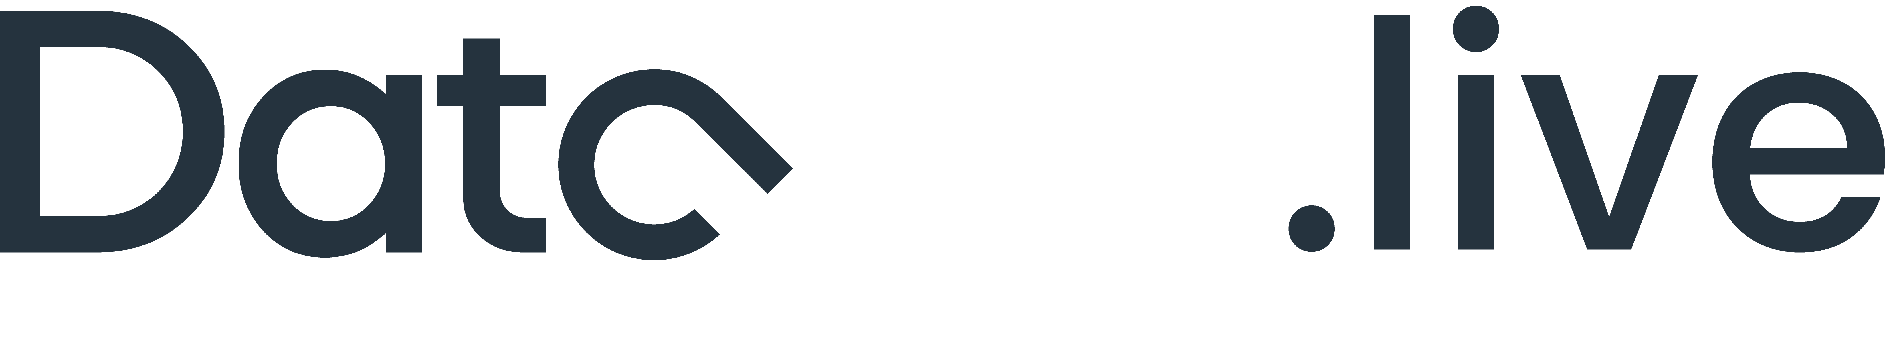
The Data Product Company
More Frequent Releases
100x
Faster Time to Market/Value
5x
Lower Downtime
>95%
Productivity Savings
>40%
By 2025, a data engineering team guided by DataOps practices and tools will be 10 times​ more productive than teams that do not use DataOps. – Gartner Inc.​
Notes:
We here at DataOps.live set out to change the way the world builds and manages data products.
<Click>

Slide 13
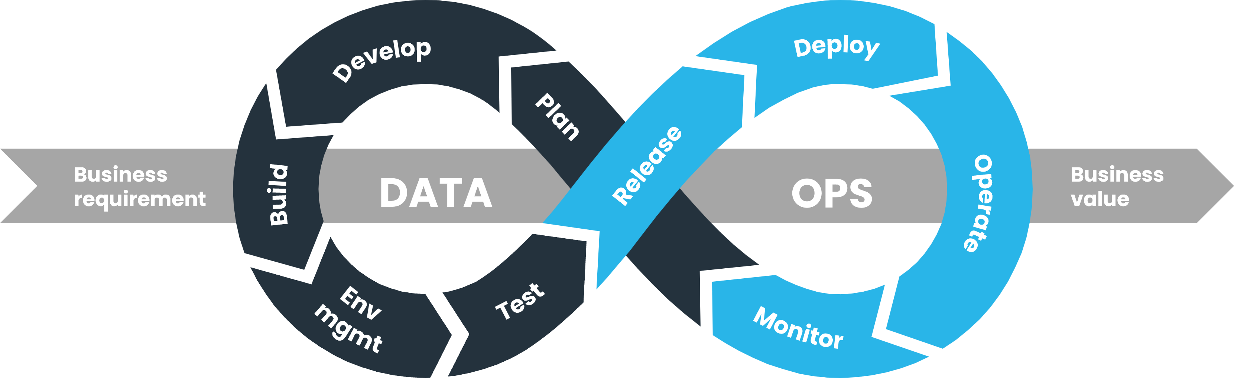
DataOps is THE critical capability needed for “data product” excellence
DataOps is true software development DevOps but modified where required to support the difference required when dealing with data (terabytes/petabytes/etc.), data environments, and unified observability.
Build Faster
Deploy Easily
Monitor & Govern
with confidence
Test Thoroughly
Notes:
Snowflake (worlds' leading data cloud) is leading the charge on enabling Data Products.
DevOps for Data is now critical.
DevOps for Data (DataOps) is now critical.

Slide 14




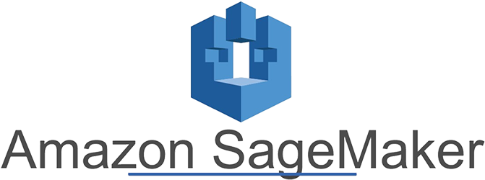



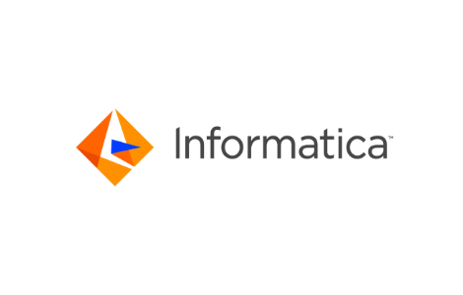
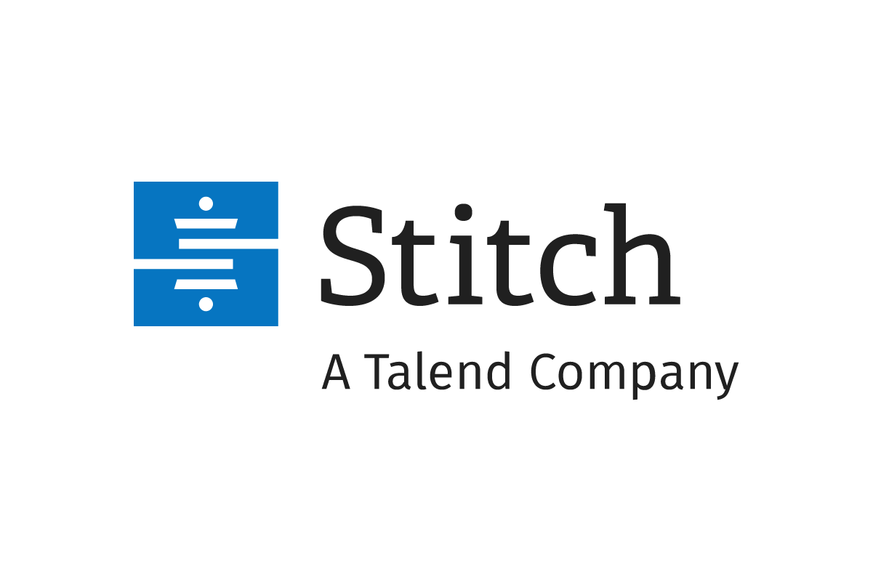




The DataOps.live Platform
Developer Experience
Unified Observability
Continuously collect, unify, manage and share Operational Metadata
Federated Deployment & Governance
Deliver Data Engineering at scale | Leverage design patterns e.g., Data Mesh or Data Vault | Deploy & Life Cycle Manage Data Products
Data Product
Environment Automation
Manage Snowflake Infrastructure as code
Pipeline Orchestration
Data Fabric End to End including Data Vault, Automated Testing
ingest/quality/test
ML/catalog
Streaming
Data Products
Databases
and files
Data Applications
Enterprises
applications
BI/Analytics
Cloud
applications
Snowflake data sharing
AI/ML
Enterprise Security
Hybrid Cloud SaaS Platform, Secrets Management, Single Sign-on, Key Based Authentication
Notes:
Storyline
we provide data operations for the modern data platform supporting the full data journey from sources to data consumers
we operate the entire modern data platform stack, from ingestion tools to catalogs
we do so by solving an organizational problem and scaling deployment and governance across the entire enterprise, not just a department or a team
we empower decision makers and data product owners alike with unified observability for their data product
to cater to the needs of a domain team when building data products, we orchestrate their end-to-end data pipelines
for each of the team members, we automate their sandbox environment, by turning their snowflake environment into a programmable engine
last, everything is powered by enterprise-grade security

Slide 15
Notes:
databases schemes views and all grants & permissions in SF (SOLE) Orchestration

Slide 16

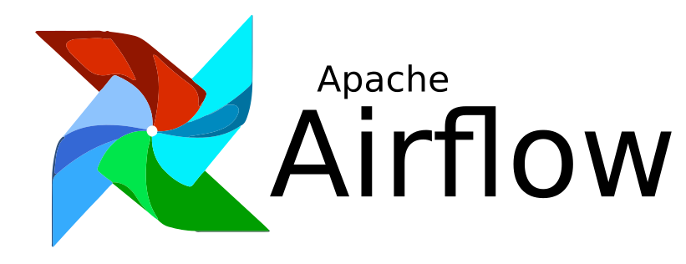

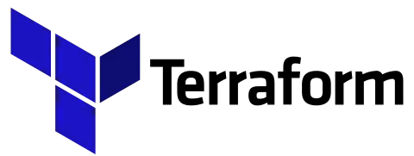

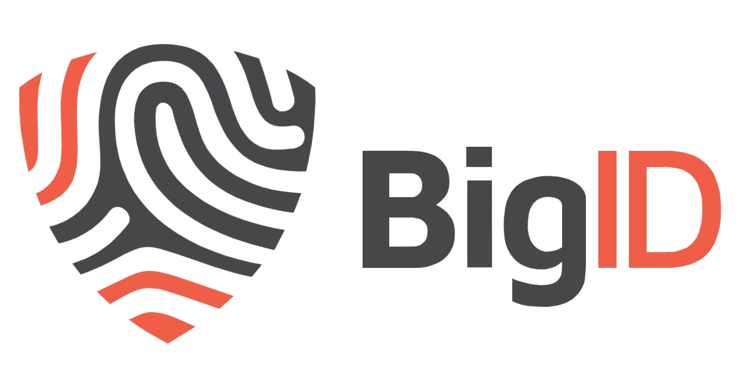




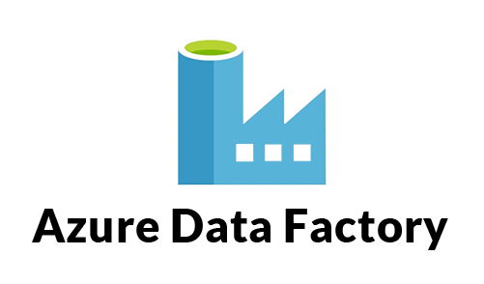



Ecosystem/build vs buy
Automate
Orchestrate
Automate
Orchestrate
Test and Observe
Develop and Deploy
Develop and Deploy
Test and Observe

Slide 17



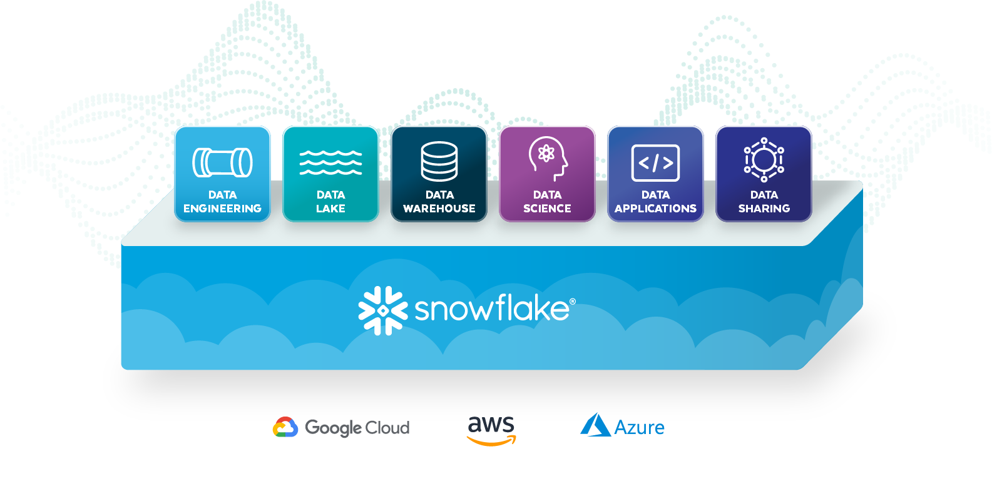
Focused on Snowflake customers
Problem
Agility
Governance
AND
Notes:
So WHO WANTS DATAOPS – WHO NEEDS DATAOPS
Its some of Snowflake’s BIGGEST customers and prospects.
And WHY – to BALANCE these two competing FORCES
On one side its GOVERNANCE – which we know is CRITICAL
Security, PII, GDPR, everything
and Snowflake delivers on all of this and More
But on the other side its AGILITY
BECAUSE THE BUSINESS WANTS THINGS FASTER AND FASTER
To deliver more value to the BUSINESS
AND THIS IS SUMMED UP IN THE NEXT SLIDE – the UNREASONABLE stakeholder
click

Slide 18
Business Value
Automation built by consultants for consultants
Accelerate Onboarding
Data Stack Agility and Scale
40% Increase Efficiency
Save money, time and lower risk onboarding data to Snowflake through automation from months to weeks with built in data governance and security. From months to weeks.
Manage data stack complexity with centralized orchestration – use & test data tools without disrupting pipelines. Scale data product delivery and output by 10x – quarterly to daily releases.
Higher productivity in a shorter timescale with fewer deployment failures using rollback feature. Automates development, test and production infrastructure
Modern Data Best Practices
Outcome-focused Migration
Optimization
Enables modern data strategy, change management and compliance with a technology foundation.
Lead with value - prioritize data migration projects with the most critical, highest value datasets, applications or business units.
SpendView free observability tool helps clients identify opportunities for efficiency and cost-savings. Cost savings 15%+

Slide 19
Case Studies

Slide 20







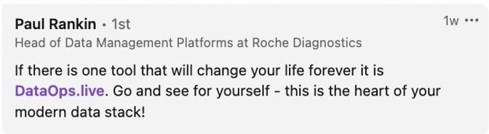
_
Source:
Snowflake Summit
June 2022
In < 18months
6-8 weeks
Average MVP time
♯40
Data product teams working
♯2680
Users, developers onboarded
120 DataOps Engineers
(198 @ Jan 23)
#50 data products
Published following FAIR principles
120 releases
last month, vs 1 release previous quarter
15+ Tools orchestrated
$40+ million cost savings
Roche: Doing now what patients need next

Slide 21
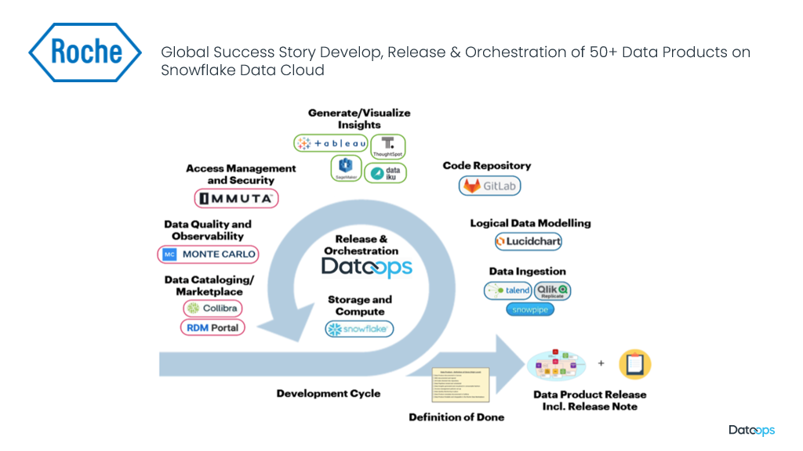
Global Success Story Develop, Release & Orchestration of Data Products on Snowflake Data Cloud

Slide 22
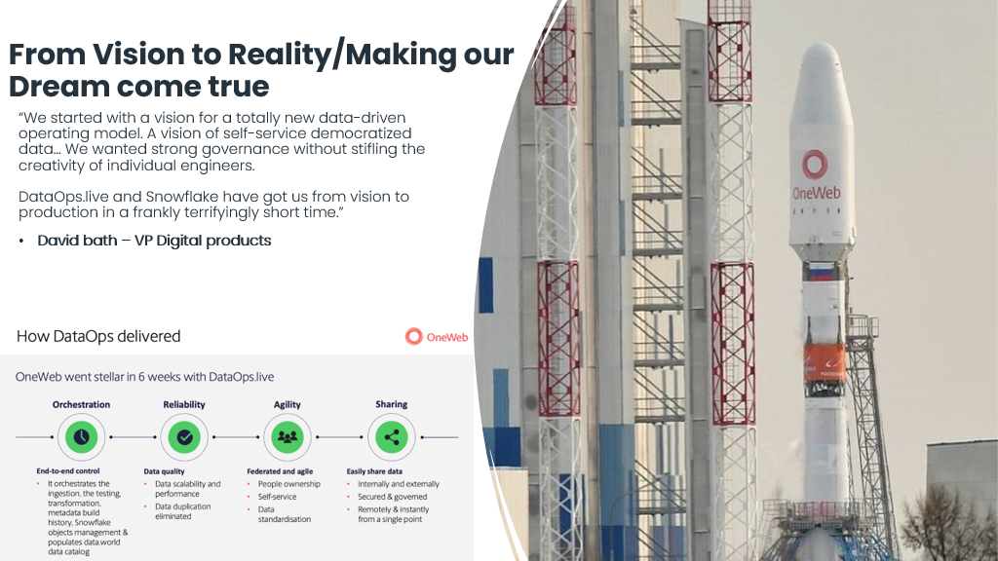

Slide 23
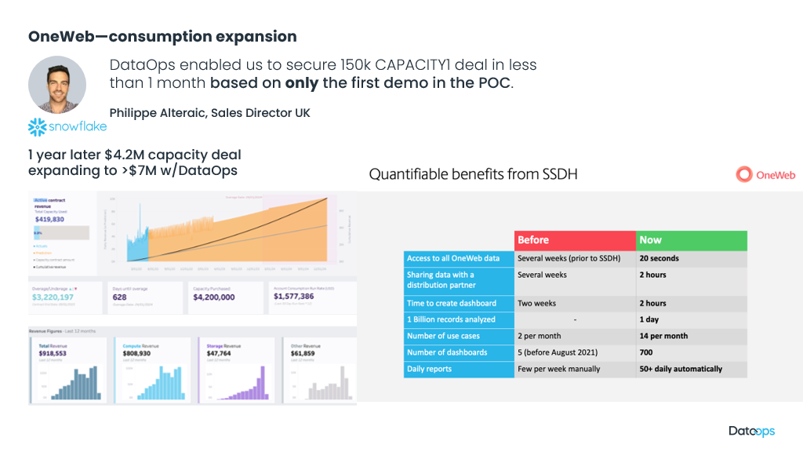

Slide 24
Finding the Customers

Slide 25
Where do I get the most frictionless customers?
V2.0
Good Customer Profile
Ideal Customer Profile (ICP)
1. Early
2. Informed
3. Experienced
Greenfield looking for early success, but haven't experienced the pain
Struggled with entry-level projects, looking for efficiency
Created DIY or strongly committed to existing tooling / fabric
Aligned with Snowflake (prospect/new cust)
Need to get to value fast
Potential “Education sale” as just moved to Snowflake
Educate on diy tool approach vs. e2e dataops
Good prospect but longer process (more friction)
Requires PoV
Know that automation is critical
Have tried a DIY approach and struggled
DevOps culture
Clear picture of end goal
Skills gaps in team evident
Excellent prospect
Requires PoV
Established approaches in place
Feel they have solved it
High political & technical baggage
Process & procurement overhead
Questionable prospect unless leadership is visionary and/or they are unable to scale
Heavy Sales approach
The maturity of the prospects is not dependent on the size of the organization or the market sector
25
Notes:
JM - 2 – informed – does not fit the bill for describing the category. Examples? Abu Dhabi Ports – have felt pain – looking for a “better way” Realizing the challenge – this needs descriptions
Roche – 2.
1 – Digi-key, OneWeb, DnB Bank
1 and 2 ideal?
Validation that customers select the right technology i.e. Snowflake
This is the maturity model we heard. Is this right? What changes do we want to see?

Slide 26
Discovery Questions
Is Snowflake currently or becoming a major data source in your IT ecosystem?
Do you have a need to go fast with Snowflake? Tell me more about business drivers for this
Are you currently migrating data to Snowflake? How are you managing this project?
Tell me about your data tool ecosystem. Are you adding new tools? How does your data engineering team manage constant uptime to the business?
Are you getting the value you hoped out of Snowflake? Are costs in line with expectations?
Do you use a catalog? If so, is it well connected to Snowflake and your data ecosystem?
What kind of demand is there for data products from your business stakeholders? How will that grow over time and how will your data team meet changing needs?
Is your company considering data sharing with 3rd parties and a data monetization strategy? How are you planning to govern and protect data?

Slide 27
Tips from the field
How do you manage lifecycles in Snowflake? How hard is it to make changes?
Do you currently test before rolling out new things in your data pipeline?
Best Champion is the person who manages the data engineering/development team

Slide 28
DataOps.live and Partners Accelerate Snowflake Value
DataOps & Partner
Partner
Onboarding & Migration
Productivity & Cost management
Scale -Managing complex data pipelines and many 3rd-party tools
Data governance and compliance
Query optimization and performance tuning
Infrastructure Planning & Provisioning
Security and access controls
Data sharing & Collaboration
Data strategy
Data modeling & Schema Design
User training and skill development
Change Management & Adoption
Advanced Analytics
Data archiving and lifecycle management

Slide 29
Differentiation

Slide 30
Our primary competitor is Manual Build
Automate
Orchestrate
Automate
Orchestrate
Test and Observe
Develop and Deploy
Develop and Deploy
Test and Observe

Slide 31
Unique value drivers
DataOps – Automating the build, test and deploy of data
applications and data products on the Snowflake Data Cloud
Business and
Developer Agility
Trust and
Observability
Security and
Governance
Deploy new products
in days not months
Changes live in hours
not weeks
Declarative automation
of everything Snowflake
Extensible container-based architecture – orchestrate anything
Fully git-based
development flow
Automated Unit and Data Testing at every stage
Publish only when you
know data is good
End-to-end logs and
monitoring in a single view
Maintain point-in-time histories of every pipeline run
Roll back configuration
and data to a point in time
Hybrid cloud/on prem
execution model
Secrets Manager integration
for any tool in the ecosystem
Who changed what, when, where, why
Org wide configuration
and code reuse
Define grants along
side functional logic

Slide 32
DataOps.live Unique Differentiation
Complete engine for declarative definition of every Snowflake object
  Environment Management
  Automated Sandbox Creation
First and only Data specific Development Environment
  Snowflake automation
  Modeling, transformation, dbt, automated testing
  Snowpark, Streamlit, Python
Software dev processes and tools adapted specifically for data
Federated project inheritance and overrides
  Federated governance and guard rails
Data Products as a First Class Citizen

Slide 33
The DataOps Platform – unique IP
Full Orchestration and control of:
Unified Developer Experience
Federated Deployment & Governance
Deliver Data Engineering at scale | Leverage design patterns e.g. Data Mesh/Data Vault | Deploy & Life Cycle Manage Data Products
Unified Observability
Continuously collect, unify, manage and share Operational Metadata
Pipeline Orchestration
Data Fabric End to End including Data Vault, Automated Testing
Complete engine for declarative definition of every Snowflake object
Environment Management
Automated Sandbox Creation
Environment Automation
Manage Snowflake Infrastructure as code
Pipeline Vault
Integration into AWS Secrets Manager, Param Store, Azure KeyVault and Hashicorp Vault
Resilient hybrid agent
Enterprise Security
Hybrid Cloud SaaS Platform, Secrets Management, Single Sign-on, Key Based Authentication

Slide 34
The DataOps Platform – unique IP
First and only Data specific Development Environment: Snowflake automation/modeling, dbt, Snowpark, Streamlit, Python, R
Software dev processes and tools adapted specifically for data
Unified Developer Experience
Federated Deployment & Governance
Deliver Data Engineering at scale | Leverage design patterns e.g. Data Mesh/Data Vault | Deploy & Life Cycle Manage Data Products
Federated project inheritance and overrides
Federated governance and guard rails
Data Products as a First Class Citizen
Unified Observability
Continuously collect, unify, manage and share Operational Metadata
Pipeline Orchestration
Data Fabric End to End including Data Vault, Automated Testing
Collection of meta data from all orchestrated tools
Standardized Data Ontology
Complete application stack for visualizing or querying unified data
Environment Automation
Manage Snowflake Infrastructure as code
Enterprise Security
Hybrid Cloud SaaS Platform, Secrets Management, Single Sign-on, Key Based Authentication

Slide 35

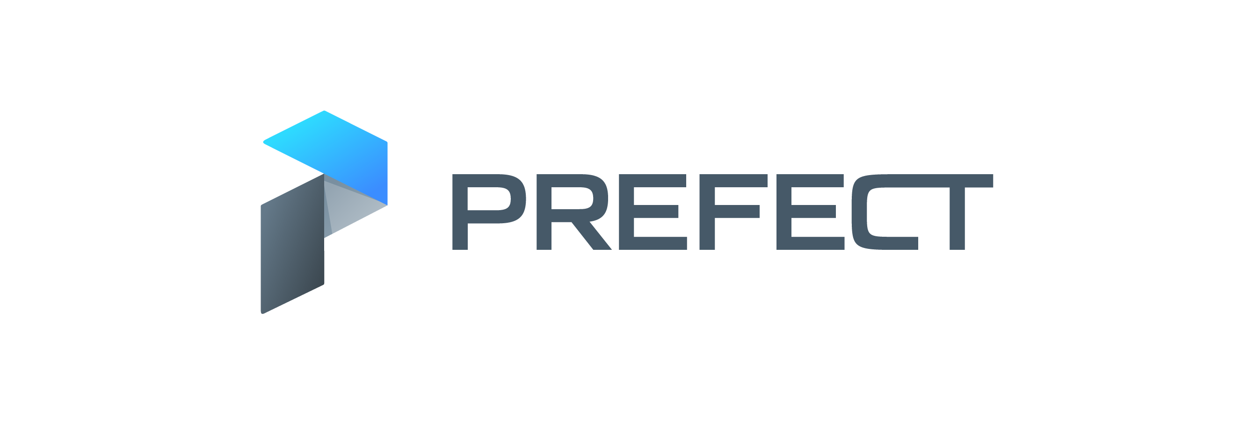

The right solution – Data Engineering at scale
Self Service Teams
Self Service Teams
Additional
tools and
custom
generated
code
required
Enterprise
Enterprise
Core functionality
Multi-Team
Multi-Team
Team
Team
Engineer
Engineer
Notes:
Prefect, Astronomer, Airflow, Dagster – have appeal and relevant for a set of individual Engineers and individual teams. However, as the organizational complexities go up, the tool complexity goes up, more tools need to be added etc, customers have to add a lot more of their own code and the overall value goes down
DataOps complexity doesn’t change at scale and so value actually increases
In fact – we have strong value proposition and messaging that appeal higher up in the org around Governance, Security, Repeatability, lowering skills requirements etc
Prefect, Astronomer, Airflow, Dagster tools solve some Engineer problems
DataOps solves Engineer problems AND Business problems
Looked at another way, the left hand column could apply to Big Query – it’s a highly technical tool, loved by some Engineers, but very rarely adopted/relevant at large organization scale. The column on the right could represent Snowflake (and perhaps Synapse) – they still meet the needs of the individual Engineers, but have a much wider and cleaner organizational play.
How have we achieved this? We built DataOps.live using the principles, practices and technologies that the software world have used at MASSIVE scale. All of our founding team have careers in Enterprise companies and how to meet their requirements.

